Slide 1

CS483 Digital Forensics
Windows Internals II

Slide 2
Review Questions
What is a DLL?
What are the major roles of ntdll.dll?
What is a process?
What is a handle?
What’s the difference between CreateFileA and CreateFileW?

Slide 3
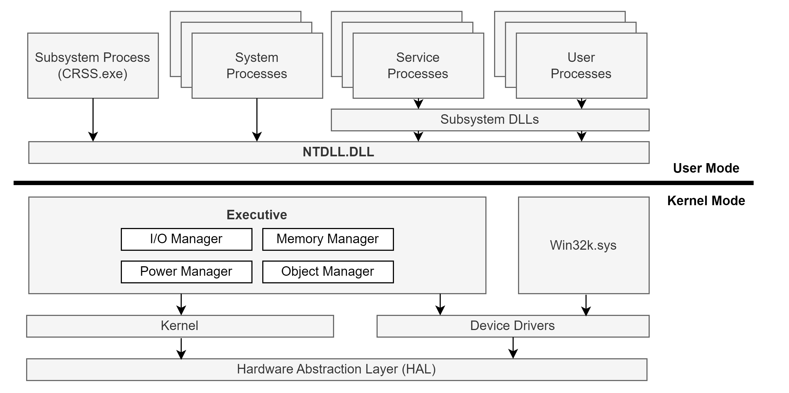
Windows Architecture Overview
Notes:
User Processes – Normal processes based on image files (PE32 exe files), such as notepad.exe, cmd.exe, explorer.exe, etc.
Subsystem DLLs – Dynamic Link Libraries (DLLs) that implement the API of a subsystem. A subsystem is a view of capabilities the OS exposes to processes. These DLLs, found in C:\Windows\System32, export the officially documented API of Windows (Win32 API)
NTDLL.DLL – Implements the Windows Native API. This is the lowest layer of code in user mode. It contains system call wrappers to transition into kernel mode (trap). It also implements the heap manager and the image loader.
Service Processes – Normal Windows processes that communicate with the Service Control Manager (SCM, implemented in services.exe).
System Processes – Umbrella term to describe Windows processes that are always just there. Examples include smss.exe, lsass.exe, winlogon.exe, services.exe, etc.
Subsystem Process (crss.exe) – Helper for the kernel to manage processes.
Executive – Upper layer of the kernel (NtOskrnl.exe). Hosts most of the kernel mode OS code. Contains various managers.
Kernel – Lower layer of NtOskrnl.exe. Implements the most fundamental and time-sensitive parts of the kernel mode OS. This include thread scheduling, interrupt and exception dispatching, and implements kernel primitive objects such as mutexes and semaphores.
Device Drivers – Loadable kernel modules.
Win32k.sys – Kernel module (driver) that handles the UI part of Windows
Hardware Abstraction Layer (HAL) – Abstraction layer over the hardware closest to the CPU. It allows device drivers to use APIs that do not require intimate knowledge of the hardware, such as interrupt controllers and DMA controllers

Slide 4
Lesson Learning Objectives
Research Win32 API documentation
Design, compile, execute, and troubleshoot simple Windows programs

Slide 5
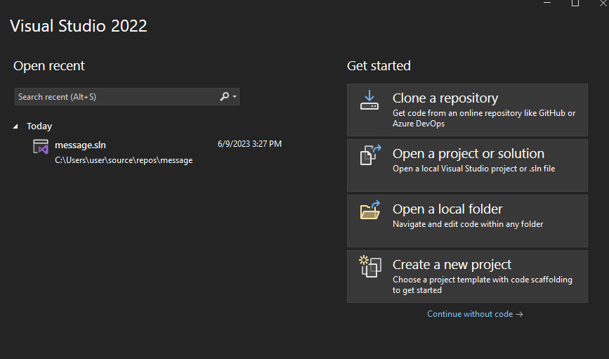
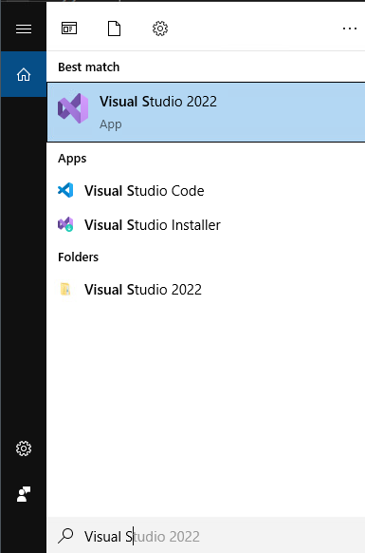
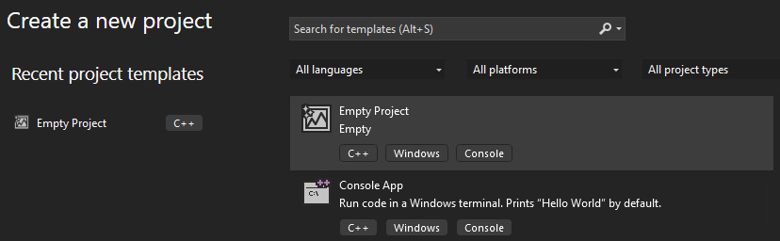
Visual Studio

Slide 6
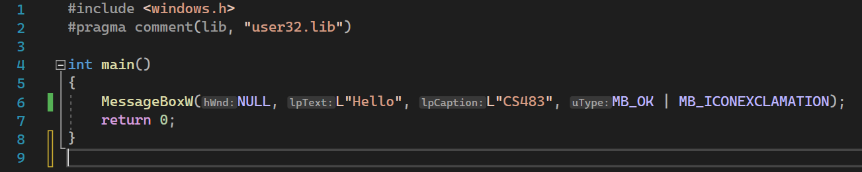
Simple Hello Program

Slide 7
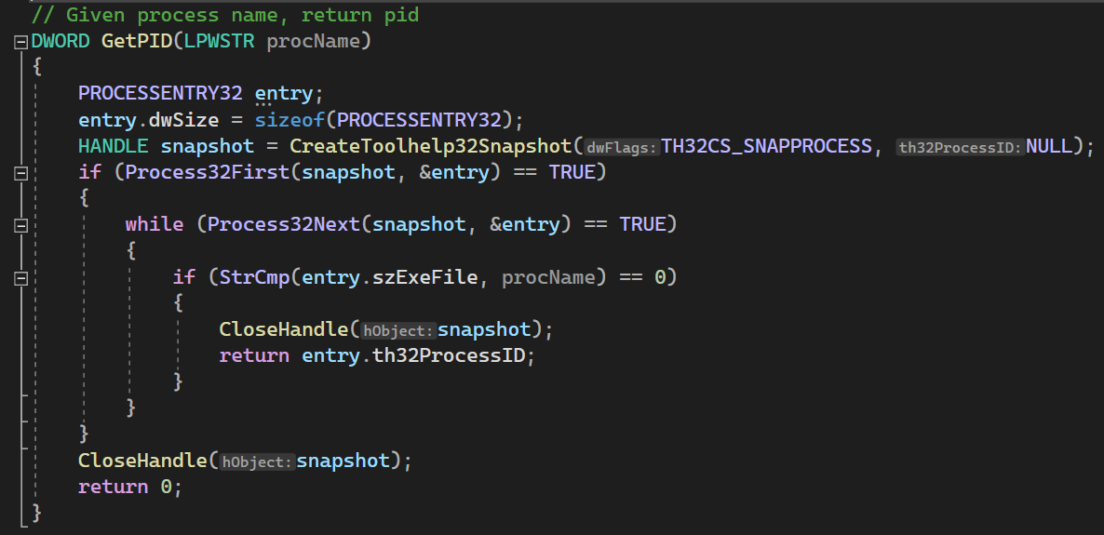
Function to Find Running Process

Slide 8
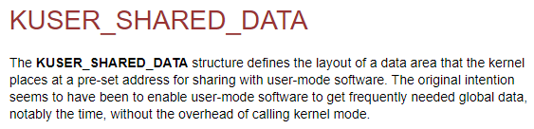
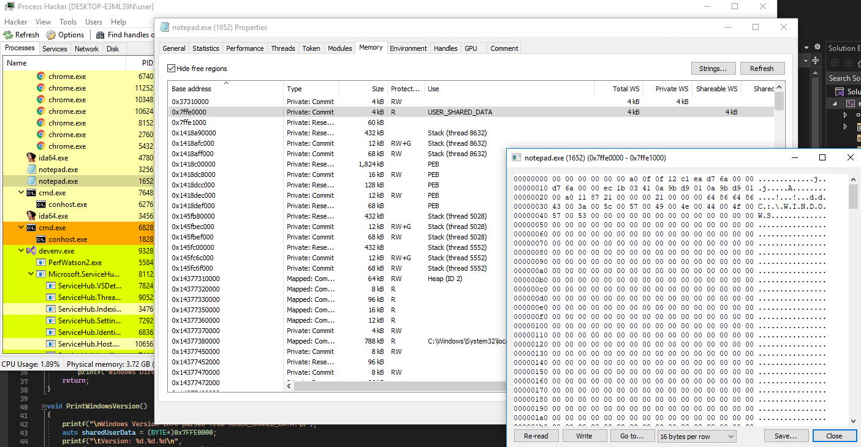
KUSER_SHARED_DATA
Notes:
https://learn.microsoft.com/en-us/windows-hardware/drivers/ddi/ntddk/ns-ntddk-kuser_shared_data

Slide 9
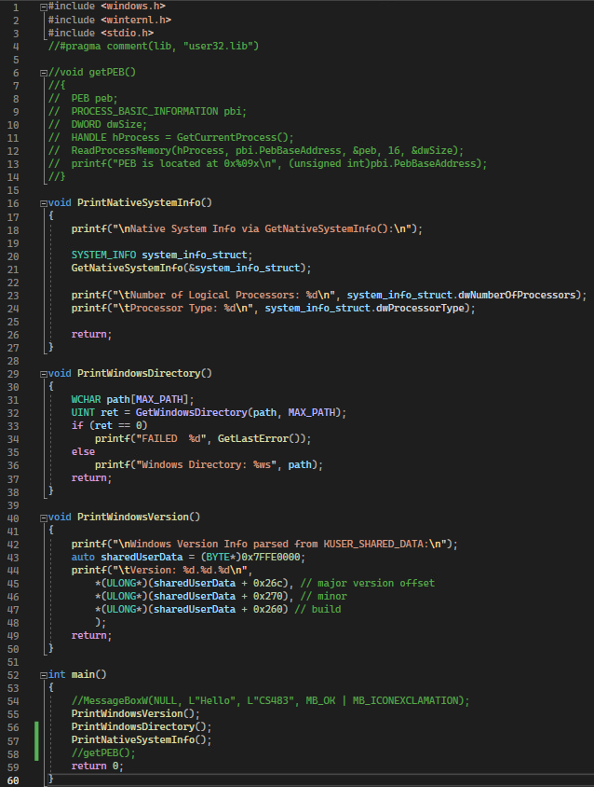
Enumerate System Information
In this example, you can extract OS version information directly from KUSER_SHARED_DATA
This example also demonstrates other system enumeration Win32 API calls

Slide 10
In Class Exploration
After you create several .exe files from your programs, explore the running process using Process Hacker
Examine memory, loaded modules, and other features to see what normal processes look like in Windows
Recompile your programs into x64, then compare the process in Process Hacker.

Slide 11
If You Remember 4 Things…
Everything is a data structure.
It’s all code. Not magic.
Abstraction leaves gaps.
Own your tools.

Slide 12
For Next Lesson
Review Slides
Research at least one Win32 API function call and write a simple Windows program on your own!
ChatGPT is encouraged for these types of exploratory learning exercises.

